Slide 1







Opportunities in AI & ML
Document Collection
M
Tokenize
Scrub
token
Mrinal – Cloud solution Architect (Advanced analytics & AI) Architect – Data & AI Certified for: Cloudera Spark+Hadoop Dev, Python, Deep Learning, SAS, R and PMP
HashJoin
Regex
token
Stop Word List
Left
GroupBy
token
R
RHS
Count
Word Count

Slide 2
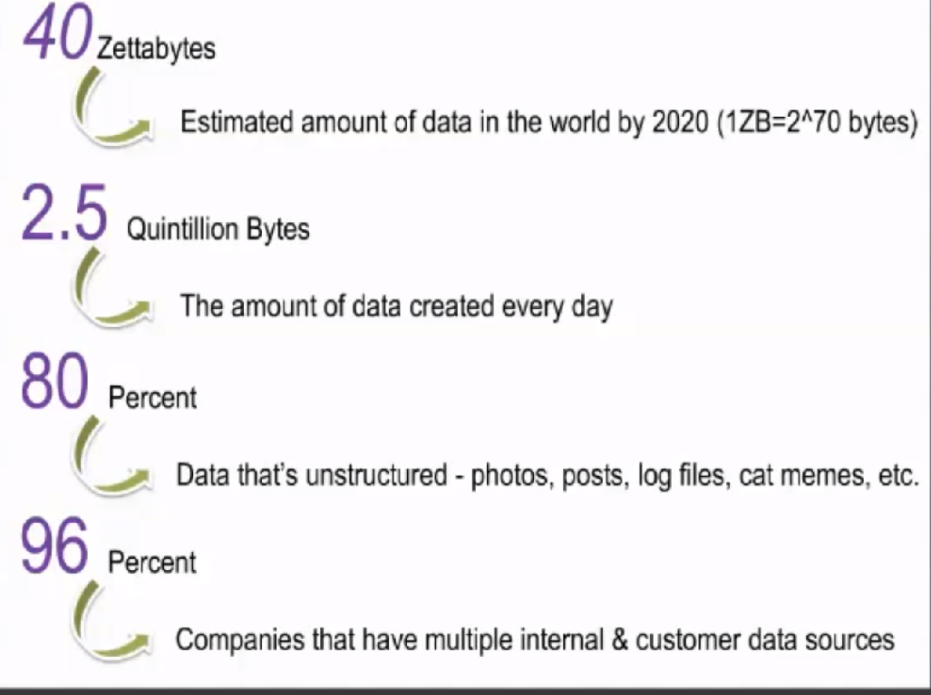
Massive Data at your door-step!

Slide 3
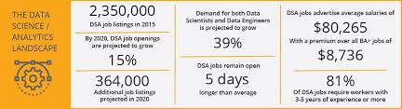
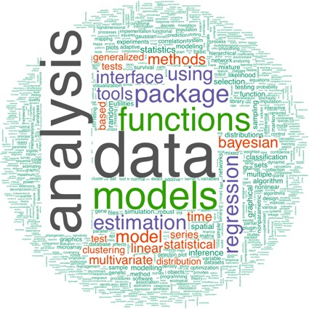
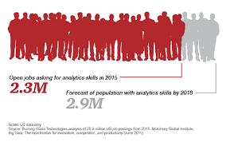
Inflection point: Demand side
source:
R-Bloggers

Slide 4
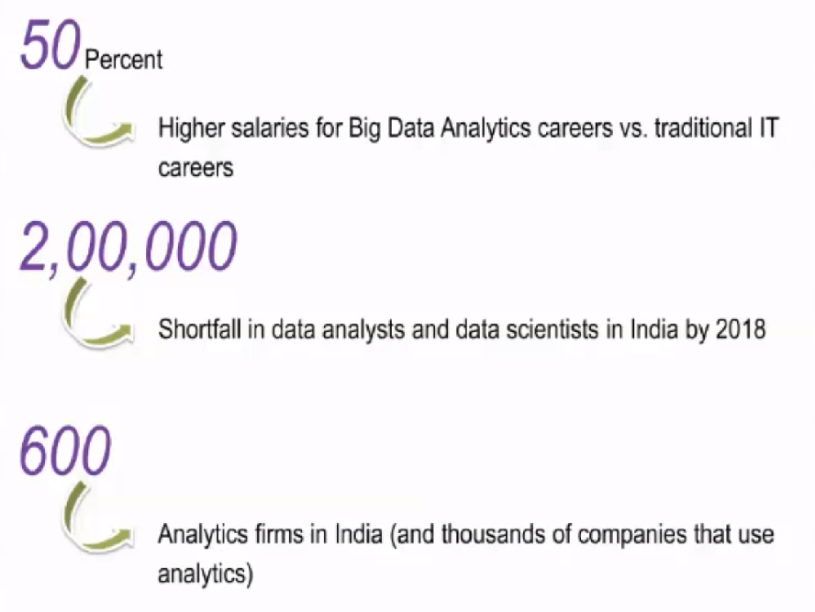
You shall get indispensable!

Slide 5
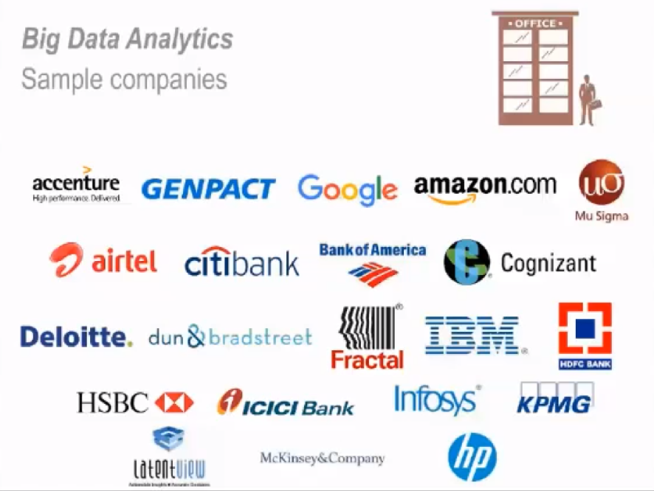

Slide 6

DataScience opportunities, but ….

Slide 7
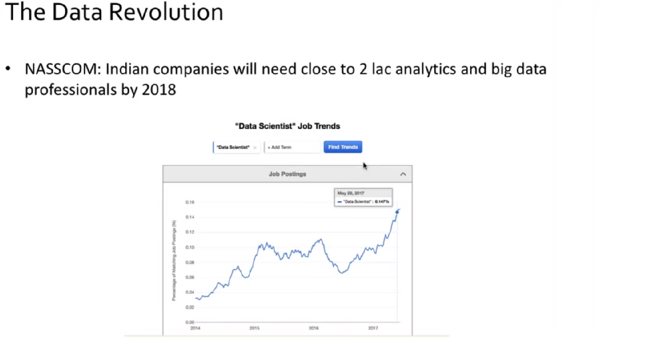

Slide 8
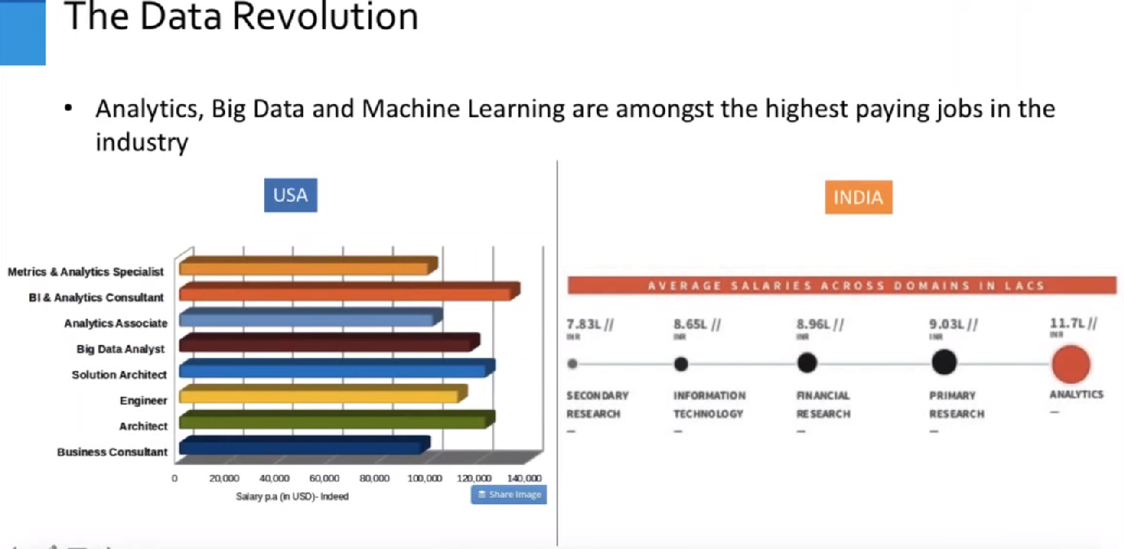

Slide 9
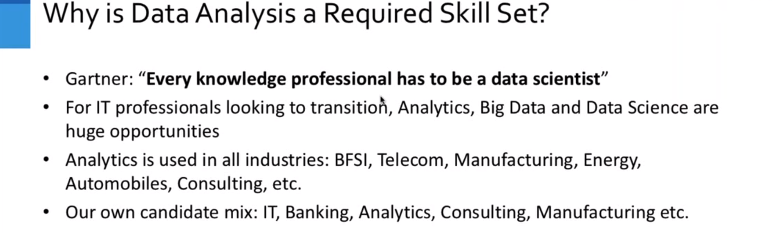

Slide 10
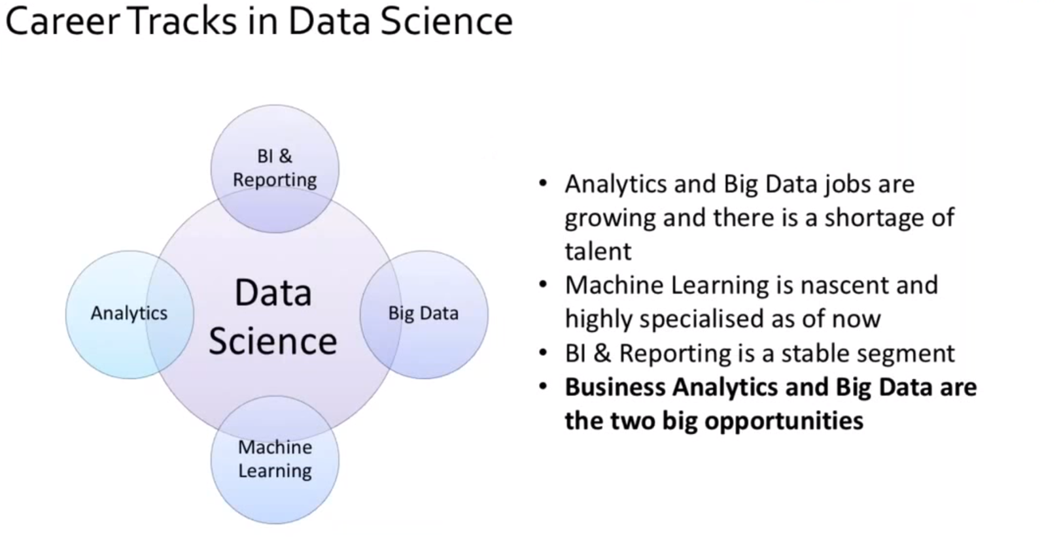

Slide 11
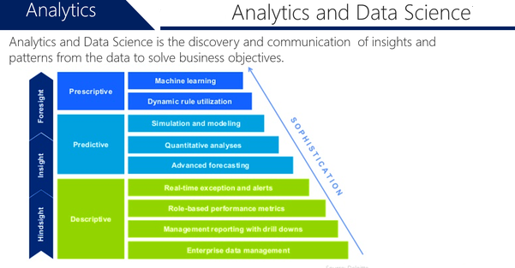
What will you learn with Us?

Slide 12
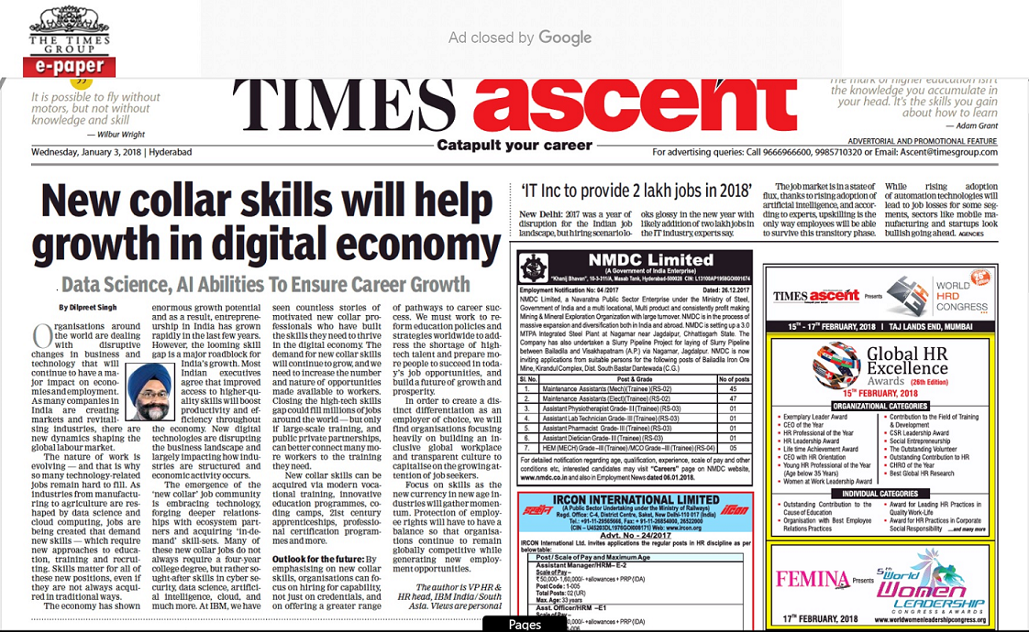
DataScience opportunities in your general Newspaper !
https://timesofindia.indiatimes.com/business/india-business/new-collar-skills-will-help-growth-in-digital-economy/articleshow/62340503.cms

Slide 13
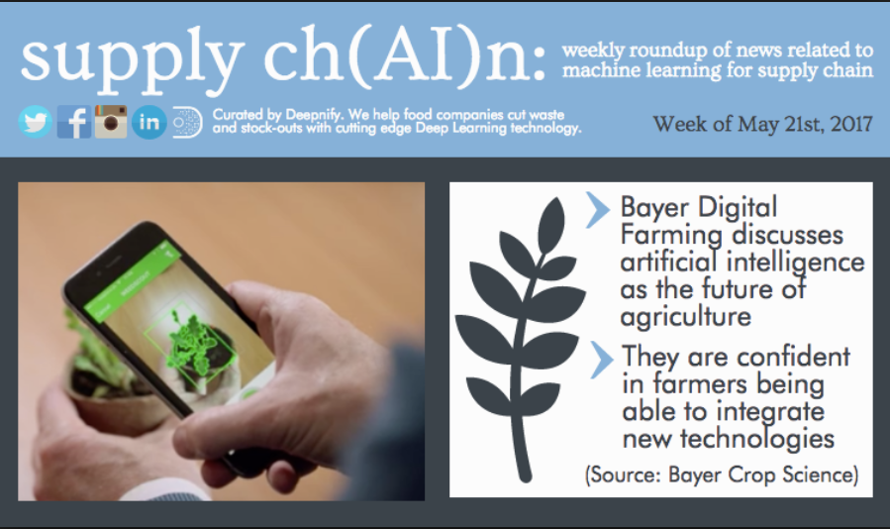
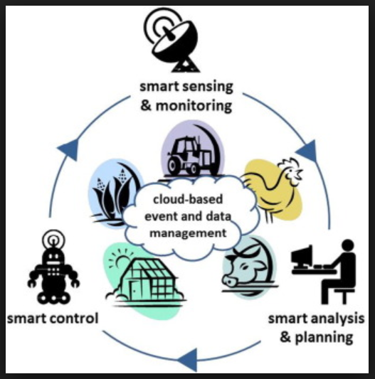
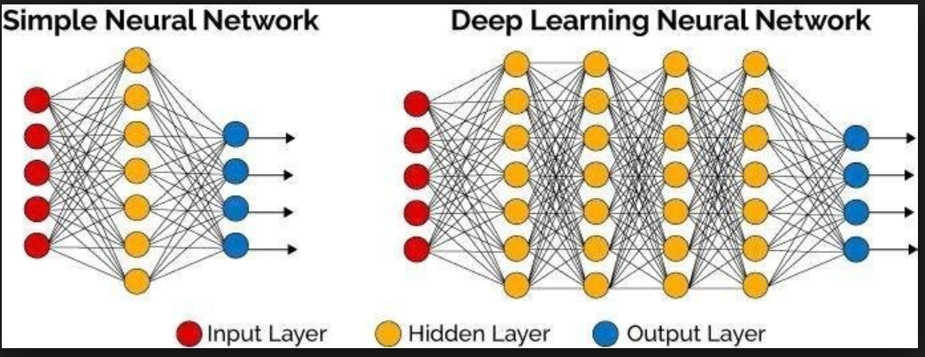

Slide 14
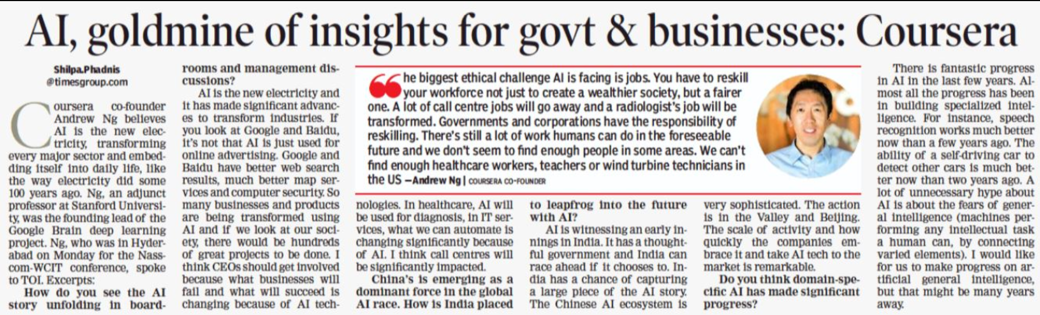
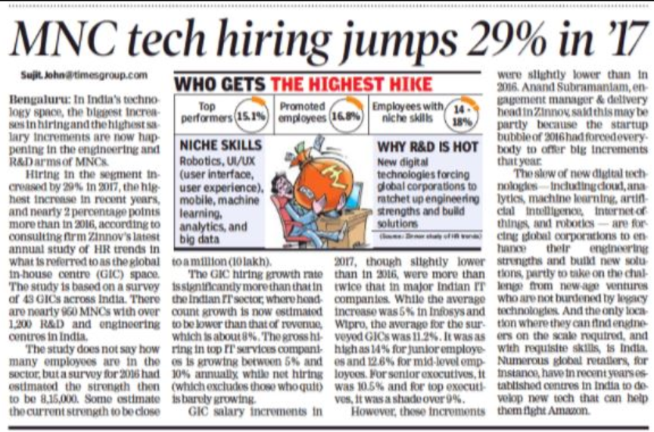
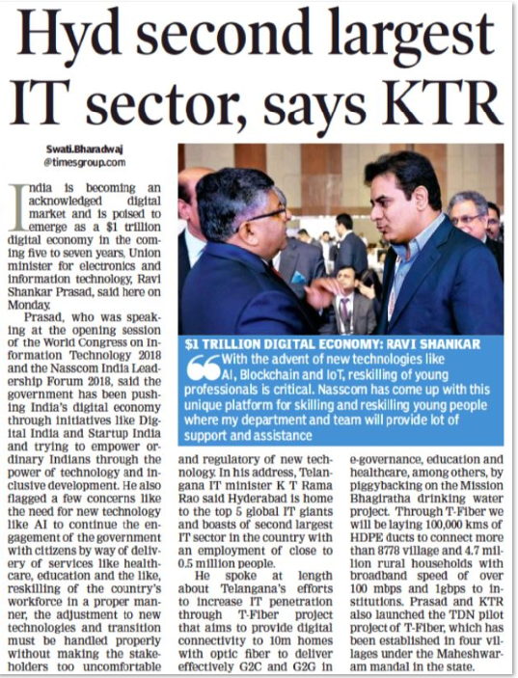
DataScience opportunities in your general Newspaper !
https://timesofindia.indiatimes.com/people/andrew-ng-interview/articleshow/62995821.cms
https://epaper.timesgroup.com/Olive/ODN/TimesOfIndia/Default.aspx#

Slide 15
matrix: Example team
discovery
modeling
integration
apps
systems
stakeholder
scientist
developer
ops

Slide 16













typical hand-offs
integrity
availability
discovery
communications
people
vendor data sources
Query
BI & reporting
data warehouse
_{H}Q_{os}u_{t}e_{s}ry
dashboards
_{Ho}q_{s}u_{t}e_{s}ry hosts
production cluster
presentations
decision support
classifiers
predictive analytics
analyze, visualize
customer interactions
recommenders
business stakeholders
internal API, crons, etc.
modeling
automation
engineers, analysts

Slide 17
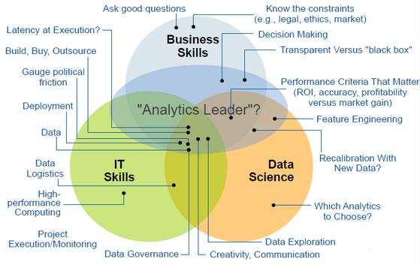
Expectation
Process
Variation
Data
Tools

Slide 18
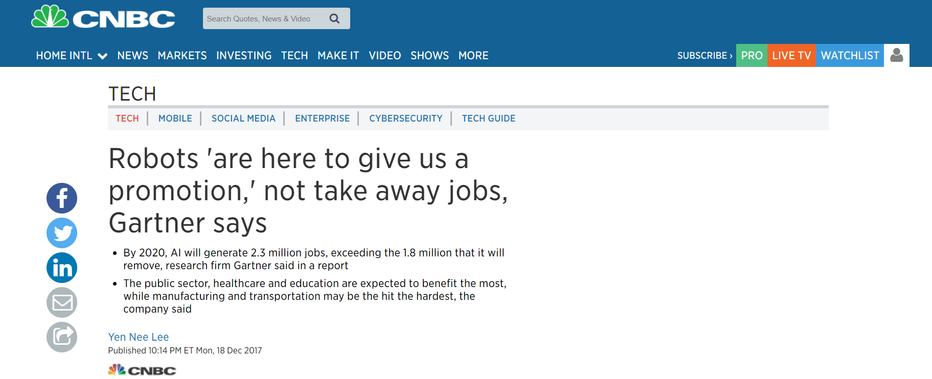

Slide 19
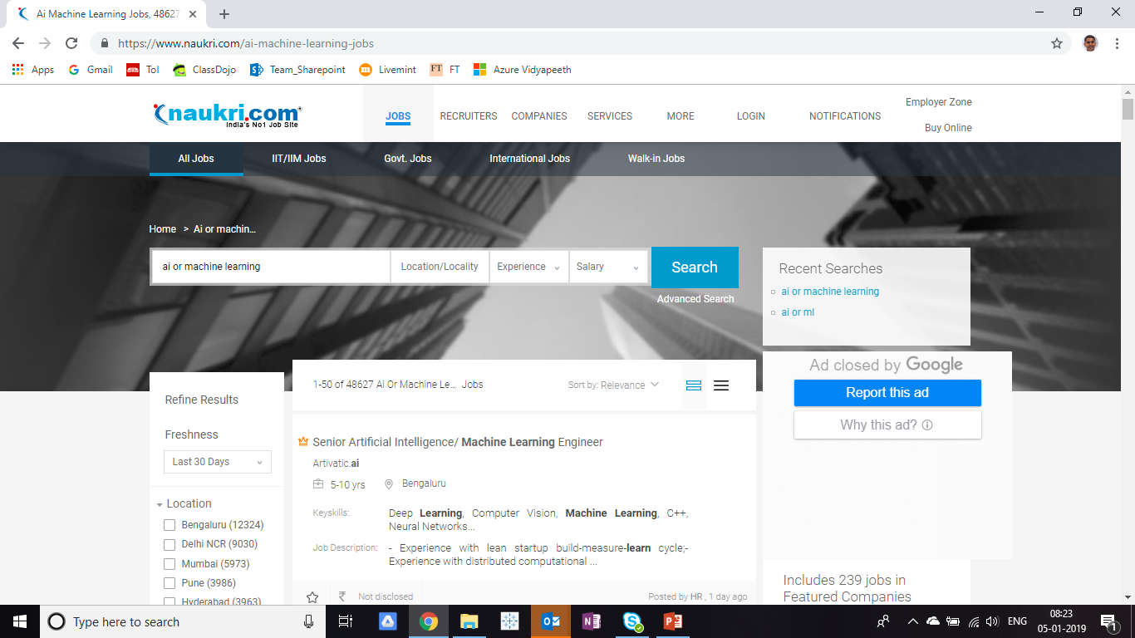

Slide 20
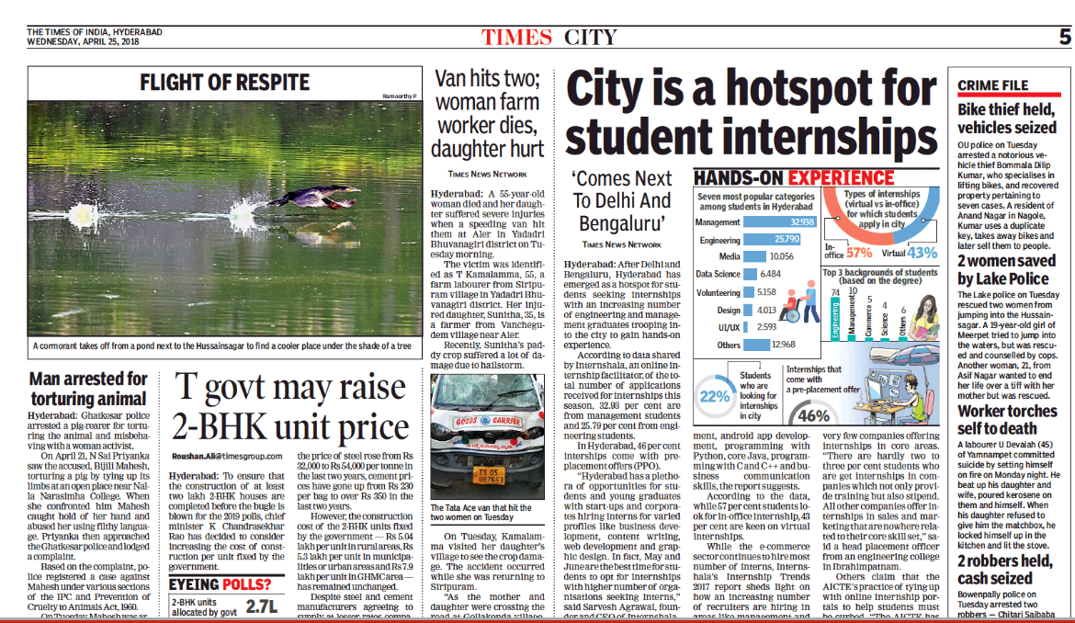

Slide 21
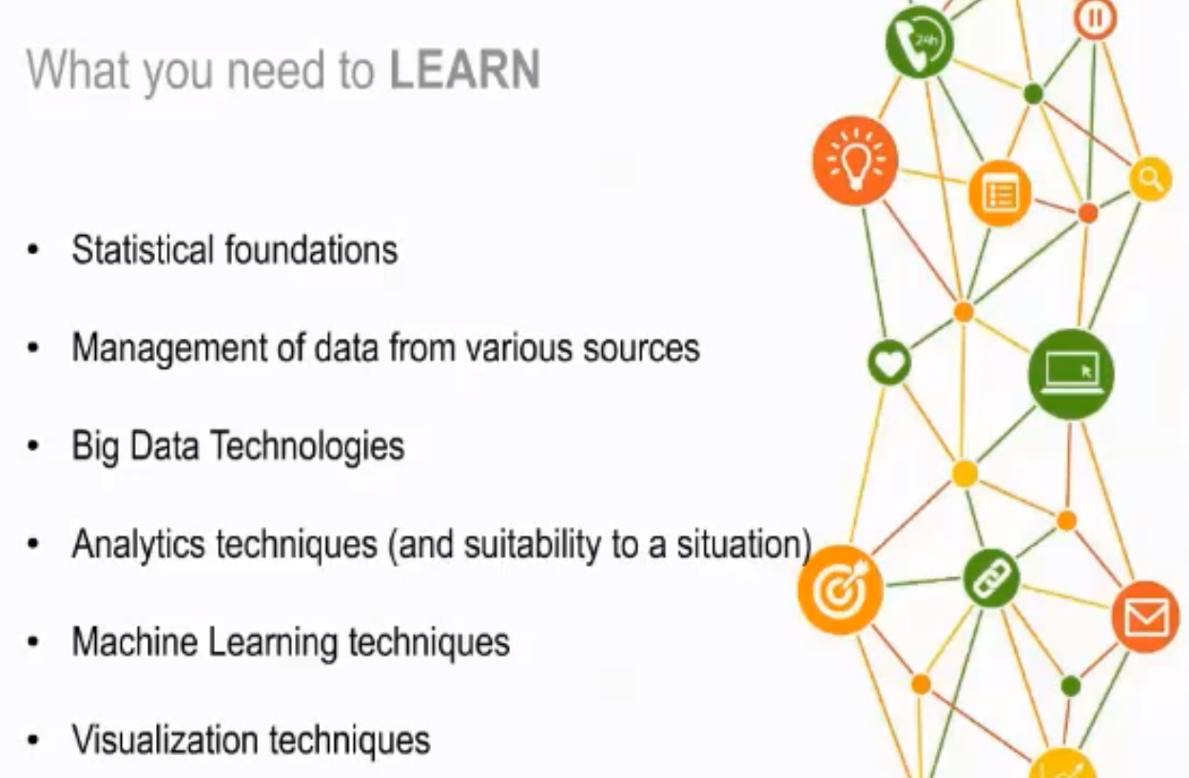

Slide 22
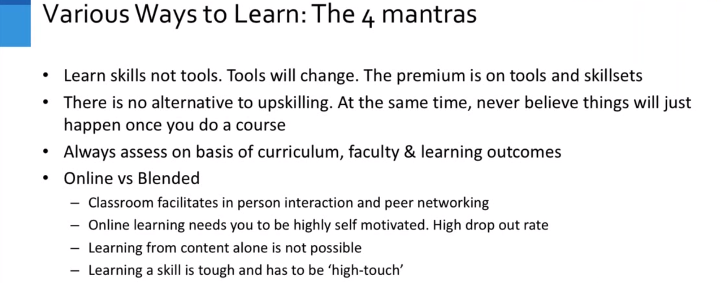

Slide 23
Thank – You Get Started !
Document Collection
M
Tokenize
Scrub
token
HashJoin
Regex
token
Stop Word List
Left
GroupBy
token
R
RHS
Count
Word Count

